Slide 1
Smart Greenify Device
A project that makes indoor planting easier!

Slide 2
Interfacing USB Camera with Raspberry pi
Presented by,
Anna Joy (C0769402)
Group 1, Individual meeting 2

Slide 3
Introduction
Smart Greenify is a device that helps indoor plants to survive without much effort from the owner.
The device has a camera which detects the weird spots and color changes on the plants and sends notifications to the owner.
This presentation focuses on the interfacing of USB camera with the main control unit which is Raspberry pi.

Slide 4
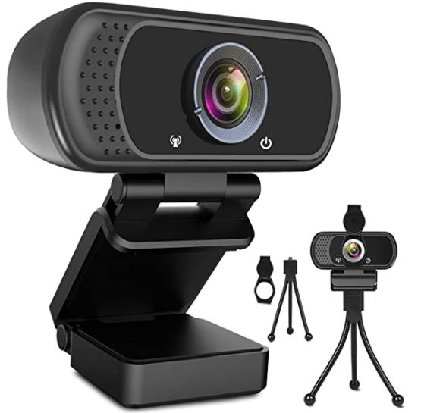
Camera Used: Webcam HD 1080p Web Camera

Slide 5
Camera Specification
Video Capture Resolution : 1080p
Lens Type : Wide-Angle
Connectivity Technology : USB
Optical Sensor Technology: CMOS

Slide 6
Raspberry pi 4 Features
High-performance 64-bit quad-core processor
Dual-display support at resolutions up to 4K via a pair of micro-HDMI ports
Hardware video decode at up to 4Kp60, up to 4GB of RAM, dual-band 2.4/5.0 GHz wireless LAN
Bluetooth 5.0
Gigabit Ethernet
USB 3.0

Slide 7
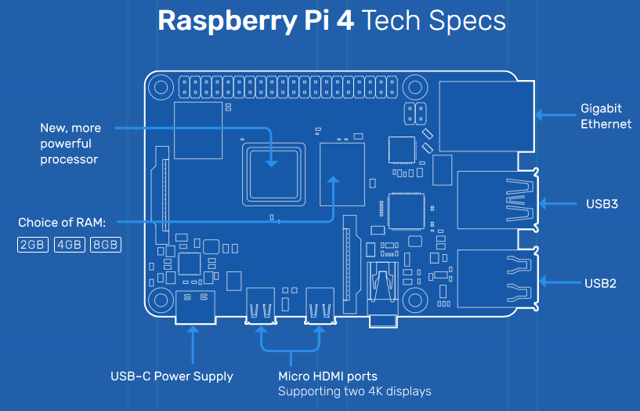

Slide 8
Raspberry pi 4 - USB interfacing
By listing the USB devices we can find out all the devices which are connected to Raspberry pi
The command used for listing is “ lsusb”

Slide 9
What is fswebcam?
fswebcam is a command to click pictures using a webcam when it is interfaced with Raspberry pi
In order to use this command we need to download and install the fswebcam package

Slide 10
Step 1
Install the fswebcam package.
Installation can be done using the command;
sudo apt install fswebcam

Slide 11
Step 2
Adding the user to ‘video’ group.
To avoid seeing ‘permission denied’ errors add the username to the video group unless we are using the default pi account.
The command is
sudo usermod -a -G video <username>

Slide 12
Step 3
Click an image using fswebcam command;
A picture will be take and saved to the corresponding file as given in the command. For example, here the file name is image.jpg
fswebcam image.jpg

Slide 13
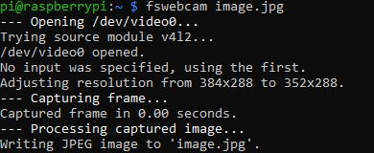
Step 3

Slide 14
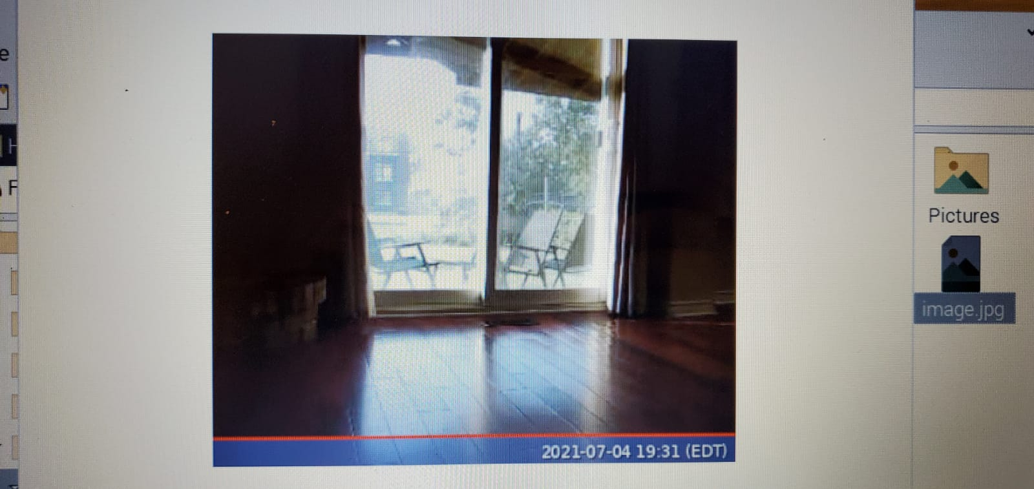
Picture Captured

Slide 15
Step 4
Specify resolution using ‘-r’ flag to take a picture.
Then the command will be
fswebcam -r 1280x720 image2.jpg
-r flag helps to take picture with the resolution we need.

Slide 16
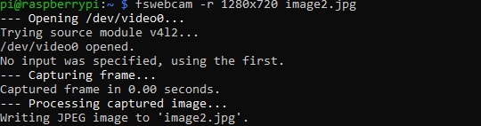
Step 4

Slide 17
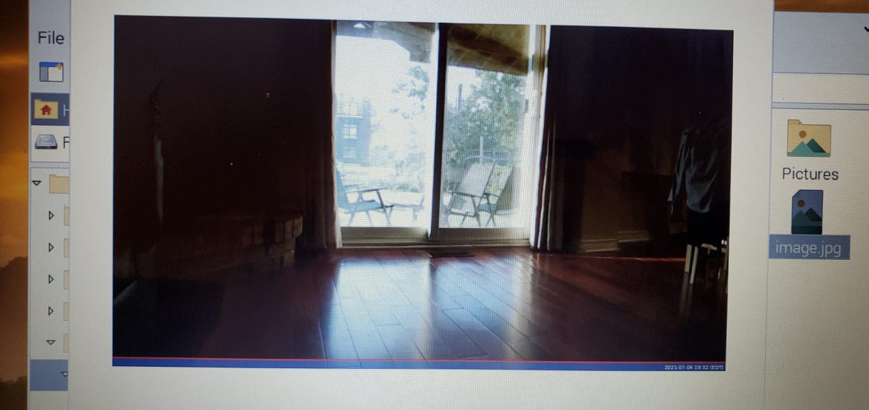
Picture Captured

Slide 18
Step 5
In the previous picture there is banner present.
So in this step add --no-banner flag.
The command is
fswebcam -r 1280x720 --no-banner image3.jpg

Slide 19
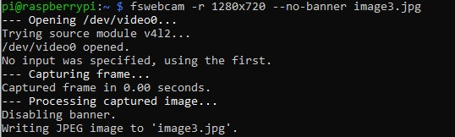

Slide 20
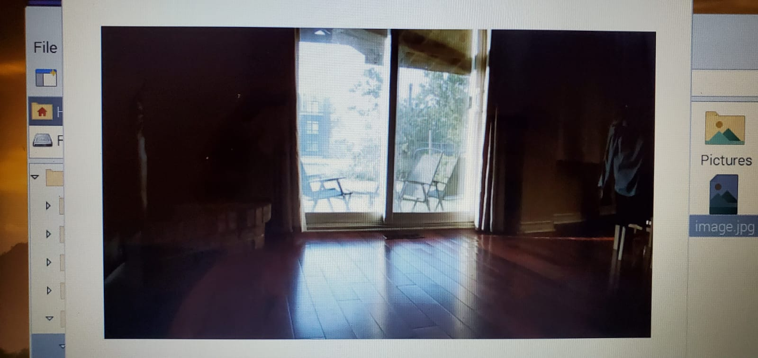
Picture with full resolution and no banner

Slide 21
Step 6
Next step is to write a Bash script to take photos.
For that first a directory should be created so that the pictures can be saved in that directory.

Slide 22

Step 6

Slide 23
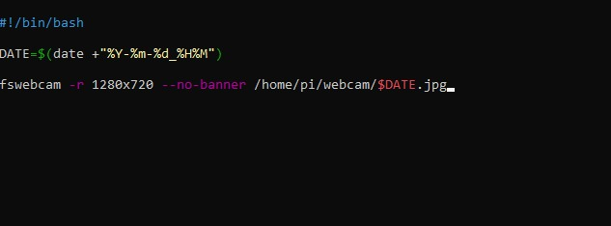
Step 7
Choose an editor and create the script

Slide 24
Step 7
This script will take a picture and name the file with a timestamp.
It is saved as webcam.sh

Slide 25
Step 8
To make the file executable we need to use the command ‘chmod’.
Here, the command will be
chmod +x webcam.sh

Slide 26

Step 8

Slide 27
Step 9
After making the script file executable, run it.
The command will be
./webcam.sh

Slide 28
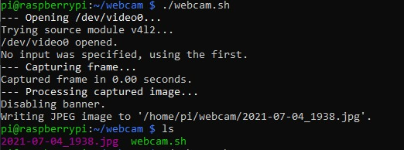
Step 9

Slide 29
Picture Captured

Slide 30
Useful Tools
ssh : to remotely access the Raspberry Pi over your local network
scp : Copy files over SSH to get copies of pictures taken on the Pi on your main computer
rsync : Use rsync to synchronise the folder of pictures taken in a folder between your Pi to your computer
cron : Use cron to schedule taking a picture at a given interval, such as every minute to capture a time-lapse

Slide 31
Thank you

Slide 32
References
Raspberrypi.org. 2021. Using a standard USB webcam - Raspberry Pi Documentation. [online] Available at: <https://www.raspberrypi.org/documentation/usage/webcams/> [Accessed 5 July 2021].
Meccanismocomplesso.org. 2021. HOW TO use a generic USB webcam on Raspberry Pi – Meccanismo Complesso. [online] Available at: <https://www.meccanismocomplesso.org/en/how-to-use-a-generic-usb-webcam-on-raspberry-pi/> [Accessed 5 July 2021].

Slide 33
References
3. Amazon.com. 2021. [online] Available at: <https://www.amazon.com/Microphone-110-Degree-Widescreen-Streaming-Conferencing/dp/B084ZJFNKN/ref=sr_1_4?dchild=1&keywords=usb+camera&qid=1625441133&sr=8-4> [Accessed 5 July 2021].
4. raspbian, E. and Meunier, V., 2021. Executing bash script from PHP on raspbian. [online] Stack Overflow. Available at: <https://stackoverflow.com/questions/46135434/executing-bash-script-from-php-on-raspbian> [Accessed 5 July 2021].

